Slide 1

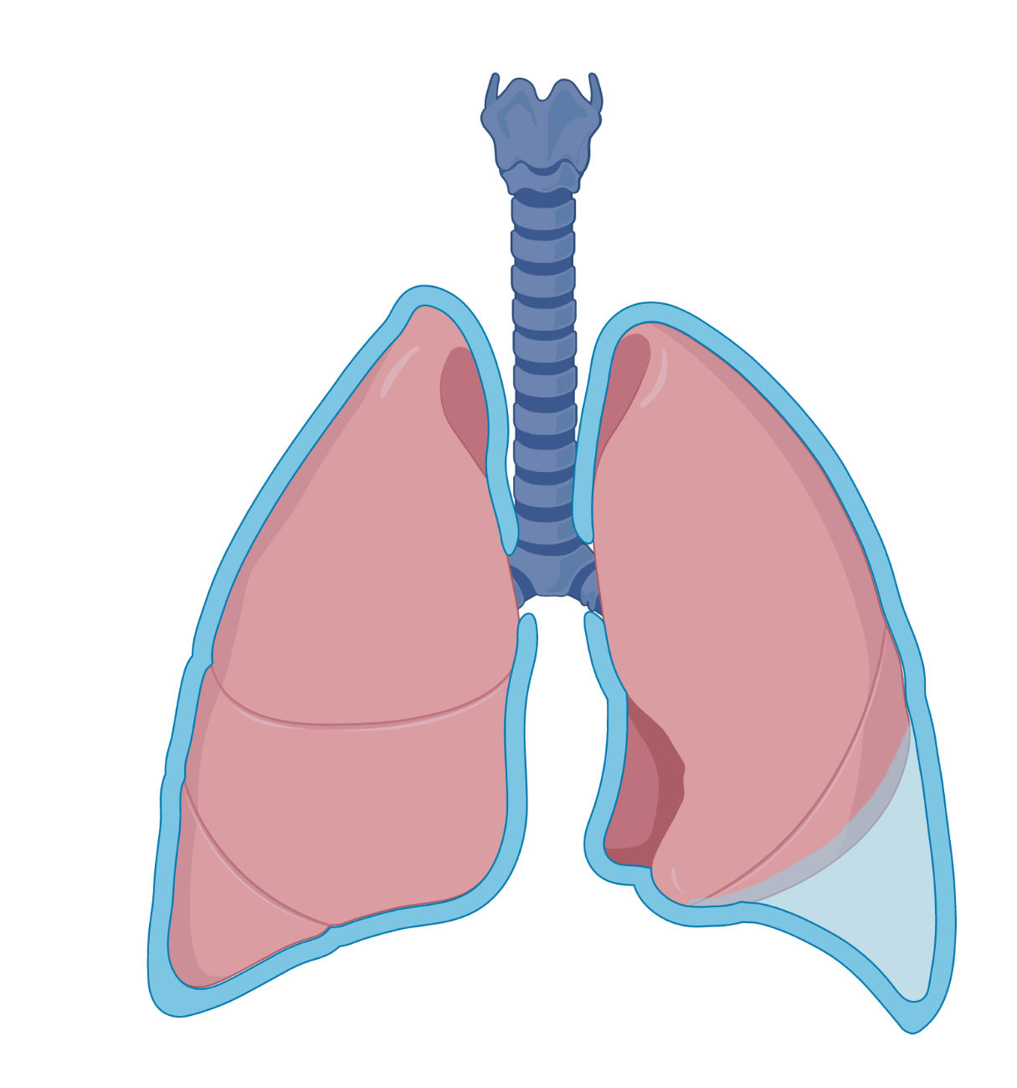


Light’s Criteria
Click these buttons to skip to each learning objective
Differential
Pleural Effusions
Management
Cases
Which pleural effusions warrant further work-up?
Which pleural effusions warrant further work-up?
Nearly all pleural effusions > 1 cm on US or lateral decubitus CXR should be further evaluated with a thoracentesis.
Image from biorender.com

Slide 2
Light’s Criteria
Specialized tests
LIGHT’S CRITERIA
Pleural studies
Specialized tests
LIGHT’S CRITERIA
Pleural studies
Protein
LDH
Gram stain and culture
Cell count
pH
Glucose
Cytology/ flow cytometry
Adenosine deaminase
Amylase
Triglycerides
Hematocrit
Differential
Pleural: serum protein >0.5
Pleural: serum LDH >0.6
Pleural LDH >2/3 ULN of serum LDH
Protein
LDH
Management
Cases
0 criteria
≥1
TRANSUDATE
EXUDATE
Click on “Bonus information” to learn more about pleural fluid testing.
Bonus information

Slide 3
Light’s Criteria
LIGHT’S CRITERIA
Pleural studies
Specialized tests
Differential
Pleural: serum protein >0.5
Pleural: serum LDH >0.6
Pleural LDH >2/3 ULN of serum LDH
Protein
LDH
Gram stain and culture
Cell count
pH
Glucose
Cytology/ flow cytometry
Adenosine deaminase
Amylase
Triglycerides
Hematocrit
Management
Cases
0 criteria
≥1
TRANSUDATE
TRANSUDATE
EXUDATE
EXUDATE
Fluid studies
Heart failure
Cirrhosis (Hepatic hydrothorax)
Nephrotic syndrome
Hypoalbuminemia
Infection (bacterial, TB)
Bacterial: ↑ PMNs
TB: ↑ lymphs
Infection (bacterial, TB)
↑ ADA, ± AFB stain/culture
Parapneumonic
Parapneumonic
↑ PMN
Malignant
Malignant
↑ lymphs
+ cytology/ flow
Peritoneal dialysis
Atelectasis
Trapped lung
Hemothorax
Hemothorax
↑ RBCs
Pleural hct:serum hct > 0.5
Chylothorax
Chylothorax
↑ lymphs
TG > 110
PE
PE
Bloody effusion
Autoimmune
(RA, SLE, GPA, Sjogren’s, sarcoidosis)
Autoimmune
(RA, SLE, GPA, Sjogren’s, sarcoidosis)
↑ lymphs
Bonus information
GI (esophageal perf, pancreatitis)
Perf: ↑ PMNs
Panc: ↑ lymphs
GI (esophageal perf, pancreatitis)
↑ amylase

Slide 4
Light’s Criteria
Management of Parapneumonic Effusions
Differential
Parapneumonic Effusion
Management
↓ pH <7.2
↓ glucose <40
↓ pH <7.2
↓ glucose <40
Septations/ loculations
Pus, organisms
Cases
Septations/ loculations
Pus, organisms
no
yes
Empyema
Uncomplicated effusion
Empyema
Uncomplicated effusion
Complicated effusion
Complicated effusion
Antibiotics + Drainage
Antibiotics + Drainage
Medical treatment of pneumonia
Pulm/IR/Surgery
Thoracic surgery
Pigtail
Surgical chest tube
VATS/ decortication
14 Fr
24 Fr
Bonus information
32 Fr
Notes:
https://www.researchgate.net/figure/Pigtail-catheter-allows-less-tension-on-the-chest-tube-to-decrease-kinking-of-the_fig1_228106440

Slide 5
Light’s Criteria
Case 1
Case 2
Case 3
Differential
46 yo presents with fevers, cough, and SOB. CXR shows a L sided consolidation and moderate pleural effusion.
72 yo with a prior CVA and chronic aspiration presents with generalized weakness, chest pain and cough. CT scan shows a loculated R sided effusion with septations and RLL consolidation.
82 yo with metastatic breast cancer presents with new onset SOB. CXR shows near opacification of the L hemithorax. Therapeutic thoracentesis is done.
Management
Cases
Pleural fluid studies
Protein 3.5
LDH 76
pH 7.26
Gram stain: + PMNs
Cell count: 350 (88% PMNs)
Pleural fluid studies
Protein 2.1
LDH 156
pH 7.46
Gram stain: + none
Cell count: 580 (80% lymphocytes)
Serum protein: 4.0
Serum LDH: 278
Pleural fluid studies
Protein 3.5
LDH 356
pH 7.16
Gram stain: + PMNs
Cell count: 980 (90% PMNs)
Serum protein: 2.5
Serum LDH: 278
Serum protein: 3.5
Serum LDH: 278
Exudate. Meets > 1 Light’s criteria (pleural: serum protein > 0.5)
Exudate. Meets all 3 Light’s criteria.
Exudate. Meets > 1 light’s criteria (↑ pleural: serum protein and LDH ratios).
Transudate or exudate?
Transudate or exudate?
Transudate or exudate?
Cytology: negative
Teaching point: In effusions of uncertain etiology, send cytology as part of the initial work-up (British Thoracic Society guidelines)
Not needed.
Specialized testing?
Not needed.
Specialized testing?
Specialized testing?
Uncomplicated parapneumonic effusion
Complicated parapneumonic effusion
Likely malignant effusion
DIAGNOSIS
DIAGNOSIS
DIAGNOSIS
MANAGEMENT
MANAGEMENT
Repeat thoracentesis.
Repeat thoracentesis. When looking for a malignant effusion, sending serial thoracenteses increases the sensitivity.
MANAGEMENT
Antibiotics + drainage of the loculated effusion (pigtail vs. chest tube). tPA may be used to help drainage.
Bonus information
Treatment of pneumonia

Slide 6
Light’s Criteria
Light’s criteria is 98% sensitive and 83% specific. However, in patients who are on diuretics, it can misclassify 25% of transudates as exudates. High pleural RBC counts also falsely ↑ pleural LDH.
In these cases, a serum albumin-pleural albumin gradient > 1.2 can identify transudate.
Pleural studies
Nucleated cells: The number of nucleated cells can help narrow the differential.
Differential
Protein, LDH
Protein, LDH
>50k
Complicated parapneumonic, empyema
Management
Gram stain and culture
10-50k
Uncomplicated parapneumonic
Acute pancreatitis
SLE pleuritis
Gram stain and culture
Cases
Cell count
Cell count
<5k
The utility of pleural fluid pH is controversial because of several factors that can influence its accuracy (exposure to air or lidocaine).
However, when sent properly, it is a good predictor for necessity of pleural fluid drainage in patients with parapneumonic effusions. These samples should be collected anaerobically, sent in a blood gas syringe with all air expelled.
The presence of organisms on gram stain or a positive culture is diagnostic of an empyema.
Chronic exudates (TB, malignancy
pH
pH
Differential: PMN or lymphocytic predominance can help differentiate the underlying etiology.
PMN – likely bacterial parapneumonic effusion or empyema
Lymphs – malignancy, TB, autoimmune, chylothorax, post-CABG, acute rejection post lung transplant. All chronic, longstanding effusions can be lymph predominant.
A low pleural glucose <60 suggests high metabolic activity and is seen in infections, malignancy, and autoimmune diseases.
TB pleurisy
Complicated parapneumonic effusions and empyema
Esophageal rupture
Malignant effusions
SLE and rheumatoid pleurisy
Glucose
Glucose
Specialized tests
British Thoracic Society guidelines recommend sending cytology in pleural effusions of unknown etiologies. Flow cytometry should be sent only in patients with suspected leukemia/lymphoma.
Serial pleural cytologies ↑ sensitivity for malignant effusions.
An ADA > 40 is highly sensitivity and specific for TB pleurisy (>90%). This is more sensitive than sputum AFB, pleural fluid AFB, culture, or biopsy.
Cytology
Flow cytometry
Cytology
Flow cytometry
Cytology | Sensitivity
1 | 65%
2 | 92%
3 | 97%
Adenosine deaminase
Adenosine deaminase
Amylase
Amylase
Typically seen in esophageal rupture, pancreatitis, or occasionally, malignancy.
Triglycerides
Triglycerides
Triglyceride levels > 110 mg/dL is suggestive of a chylothorax.
Hematocrit
Pleural fluid to blood hematocrit ratio > 0.5 is suggestive of hemothorax.
Hematocrit

Slide 7
Pleural Effusions — 2023 Context Update
Light’s criteria, the transudate/exudate differential, and the parapneumonic framework are timeless and verified current (June 2026). The items below add modern context, not corrections.
Light’s criteria unchanged: exudate if ANY one of pleural/serum protein >0.5, pleural/serum LDH >0.6, or pleural LDH >2/3 serum ULN (sens ~98%, spec ~83%). In diuretic-treated patients it misclassifies ~25% of transudates — use serum–pleural albumin gradient >1.2 g/dL to reclassify.
BTS 2023 pleural disease guideline: pleural fluid pH ≤7.2 (or frank pus / positive Gram stain/culture) indicates complicated effusion/empyema → drain. Small-bore (≤14F) chest tube is first-line for pleural infection (less pain, equal efficacy); larger bore reserved for heavy loculation or pus.
Intrapleural tPA + DNase (MIST-2, Rahman NEJM 2011) improves drainage and reduces surgical referral but does NOT lower mortality — the deck’s caveat still holds. RAPID score risk-stratifies pleural infection prognosis.
Malignant effusion: send cytology on initial work-up; serial large-volume thoracenteses raise yield (~65% → ~92% on a 2nd). For recurrent symptomatic MPE, indwelling pleural catheter and talc pleurodesis are both first-line (ATS/STS/STR 2018); IPC + talc (IPC-PLUS) increases pleurodesis success.

Slide 8
Take-Home Points
1. Evaluate any pleural effusion >1 cm on US/lateral decubitus with an ultrasound-guided diagnostic thoracentesis.
2. Light’s criteria separate transudate (non-inflammatory: heart/renal/liver failure, hypoalbuminemia) from exudate (inflammatory: infection, malignancy, autoimmune, PE, chylothorax). Any one criterion = exudate.
3. Pleural fluid studies localize the cause: cell count/differential (PMN vs lymphocyte), pH/glucose, Gram stain/culture, cytology, ADA, amylase, triglycerides, hematocrit.
4. Parapneumonic effusions: uncomplicated → antibiotics alone; complicated (pH <7.2, low glucose, loculations) and empyema (pus or +culture) → antibiotics PLUS drainage, often multidisciplinary (pulm/IR/thoracic surgery).
5. tPA/DNase augments drainage without a mortality benefit; small-bore chest tubes are first-line for pleural infection (BTS 2023).

Slide 9
Attribution & Optimization Notes
Original lesson: “Pleural Effusions,” TeachIM.org (updated Apr 2022).
Authors: Neha Deshpande MD & Ryan Murphy MD; Executive Editor Yilin Zhang MD.
Source URL: teachim.org/teaching_material/pleural-effusions/
License: Creative Commons Attribution-NonCommercial 4.0 International (CC BY-NC 4.0). Non-commercial educational use only.
Edit type: APPEND-ONLY. No surgical text change made — the standing teaching is accurate and contains no spelling/number errors. All 6 original click-to-reveal animated slides and BioRender graphics preserved.
Human review: Case 3 (slide 5, malignant effusion) labels the exudate as meeting “protein and LDH ratios,” but the LDH ratio is 156/278 = 0.56 (below the 0.6 threshold). It clearly meets the protein ratio (0.84); whether it meets the absolute LDH criterion depends on the lab’s serum LDH ULN (not given). Diagnosis/management are correct — wording left unchanged pending author confirmation.
Context added (source-cited): BTS 2023 pleural disease guideline; MIST-2 (Rahman NEJM 2011); ATS/STS/STR 2018 malignant effusion. No companion handout is published for this lesson. Medical content should be clinician-reviewed before teaching.

